Slide 1
PA Assignment 2:
Model Building

Slide 2
Table of Content
Importing library
Modelling Process & Constants
Hr Analytic (Classification Problem)
Airbnb Singapore (Regression Problem)

Slide 3
1.
Importing libraries
Package Used

Slide 4
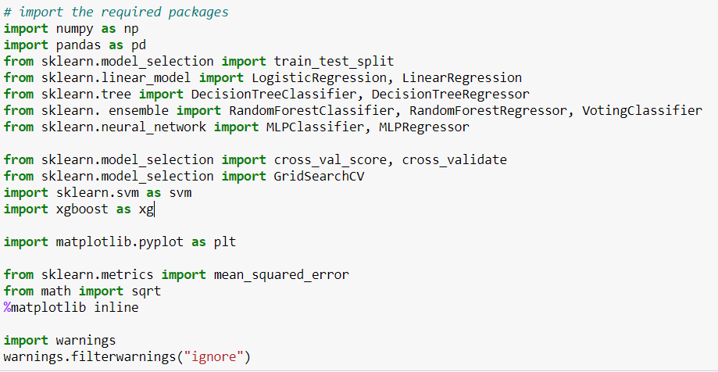
Packages

Slide 5
2.
Modelling Process
Steps taken

Slide 6
General process
Identify Approach & Set Mentality
Import & Scale Data
Build Base Models
Evaluate & Train Models
Finalized Model

Slide 7
Constant for both problem
K-Fold Validation
  To evaluate the models fairly
Scaling Most Data
  For Support Vectors Model & Multi_Layer Perception Model
Initial Model Evaluation with Base Models
  Get a sense of what the models offer

Slide 8
3.
HR Analytics
Classification Problem

Slide 9
Identify Approach & Set Mentality
In this classification problem, I want to:
Explore results of models that operate differently
Attack the problem through various angles
Conclusion: Voting Classifier
Voting mechanics enable usage of various models

Slide 10

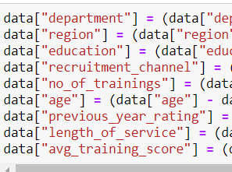
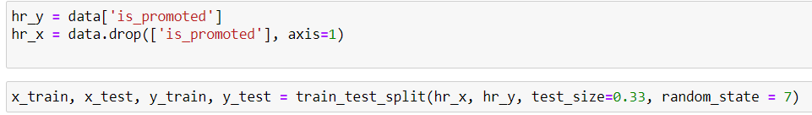
Import, Scale & Split Data
Import HR Data from ASG 1
Scale using Min-Max Normalization
Train-Test Split:
  Train Size = 67%
  Test Size = 33%

Slide 11
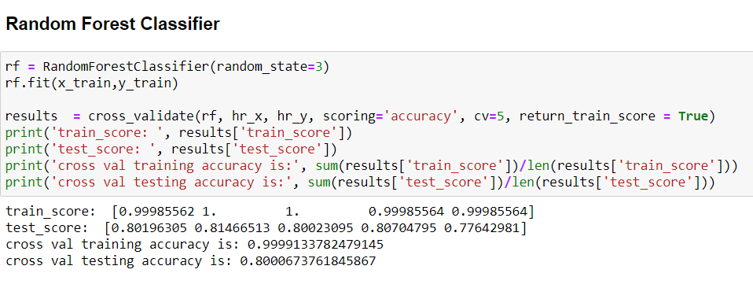
Build Default Models
To choose my models for voting classifier, I need to build some basic models first.
With that, I built 7 base classification models, such as:
Random Forest Classifier
Logistic Regression
Support Vector Classifier, Etc.

Slide 12
Build Default Models
The Results:
Some are overfitted
Others are likely Underfitted
Model Selection Checklist:
1 Tree-based model
Top 3 in test accuracy

Slide 13

Evaluate & Train Models
Primary model: Voting Classifier
Model Chosen:
Random Forest Classifier (RFC)
Support Vector Classifier (SVC)
Multi-Layer Perception Classifier (MLPC)
Voting Mechanism:
Soft (Averaging Weight)
Hard (Majority Win)

Slide 14
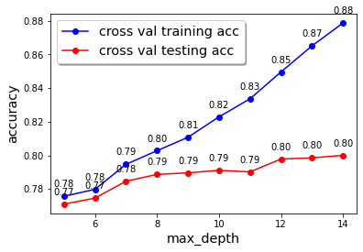
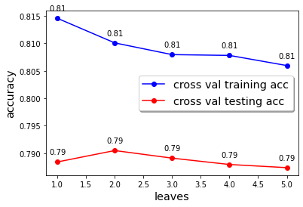

Evaluate & Train Models
First model: Random Forest Classifier
Model = Overfitted
Course of Action:
Ran a few GridSearchCV
Tuned specific parameters

Slide 15
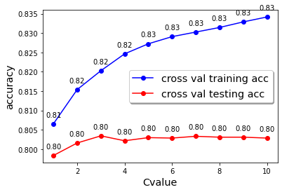
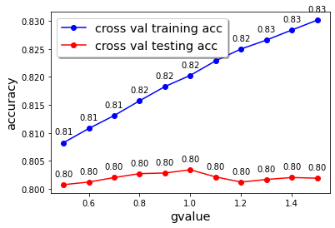

Evaluate & Train Models
Second model: Support Vector Classifier
Model = Likely Under fitted
Course of Action:
Ran a few GridSearchCV
Tuned specific parameters

Slide 16
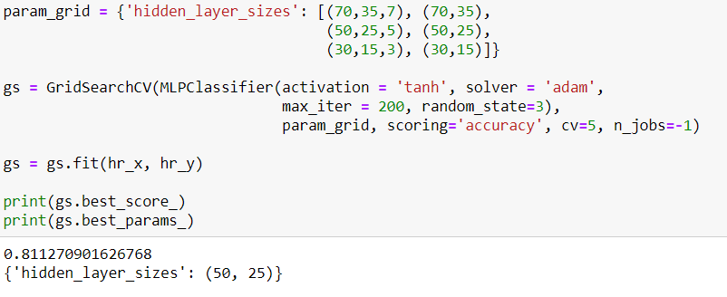

Evaluate & Train Models
Third model: Multi-Layer Perception Classifier
Model = Could be Underfitted
Course of Action:
Ran a few GridSearchCV
Tuned specific parameters

Slide 17
Evaluate & Train Models
Primary model: Voting Classifier
Model Chosen: (RFC, SVC, MLPC)
Accuracy is low likely due to noise in the data
Hence, unable to push beyond to 85%
Voting Mechanism:
Soft (Averaging Weight)
Hard (Majority Win)

Slide 18
4.
Airbnb Singapore
Regression Problem

Slide 19
Identify Approach & Set Mentality
In this regression problem, I want to:
Use the single best model for this question
Explore various models
Test bagging, boosting or neural network is better
Conclusion: Evaluate & Improve from Base Models

Slide 20

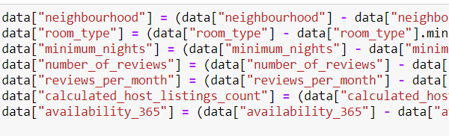
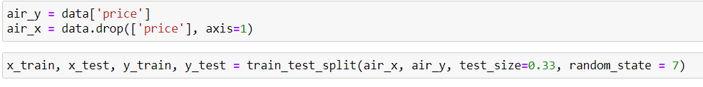
Import, Scale & Split Data
Import Listing Data from ASG 1
Dropped Latitude & Longitude
Train-Test Split:
  Train Size = 67%
  Test Size = 33%

Slide 21
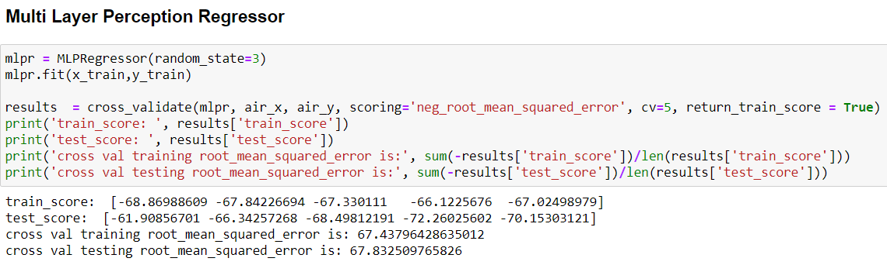
Build Default Models
To choose my models for voting classifier, I need to build some basic models first.
With that, I built 6 base regression models, such as:
Random Forest Regressor
Linear Regression
XGBRegressor, Etc.

Slide 22
Build Default Models
The Results:
2 in 3 models are overfitted
Model Selection Checklist:
1 Tree-based model
Compare bagging, boosting and neural network

Slide 23
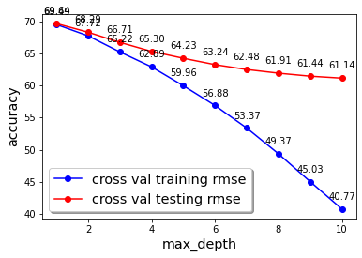
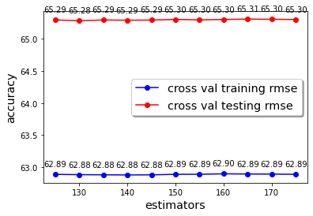

Evaluate & Train Models
First model: Random Forest Regressor
Model = Overfitted
Course of Action:
Ran a few GridSearchCV
Tuned specific parameters

Slide 24
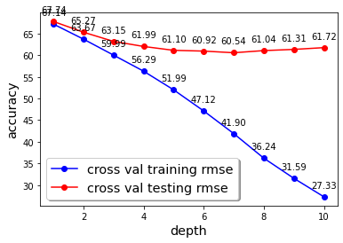
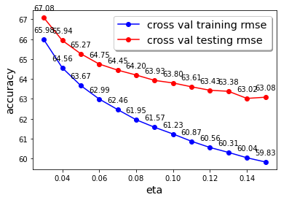

Evaluate & Train Models
Second model: XGB Regressor
Model = Overfitted
Course of Action:
Ran a few GridSearchCV
Tuned specific parameters

Slide 25
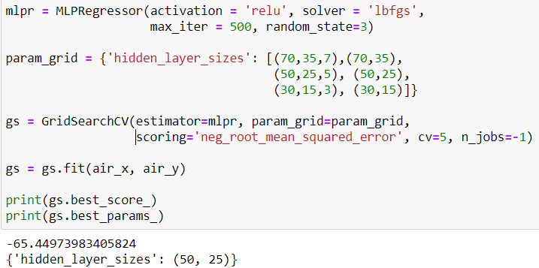
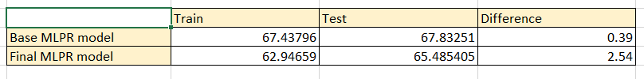
Evaluate & Train Models
Third model: Multi-Layer Perception Regressor
Model = Likely Under Fitted
Course of Action:
Ran a few GridSearchCV
Tuned specific parameters

Slide 26
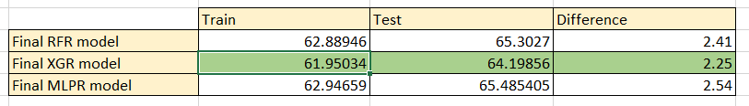
Evaluate & Train Models
Finalized model : XGB Regressor
Boosting ensemble algorithm seems better
Slight more consistent
Error is high likely due to noise in the data

Slide 27
THE END

